Slide 1

THIRD REVIEW HYBRID MACHINE LEARNING MODEL TO DETECT AND MITIGATE PHISHING ATTACKS
PROJECT CATEGORY : RESEARCH
SUPERVISED BY: STUDENT NAME & REGSTRATIONNUMBER:
DR.S. PRABAKERAN, B.TECH, M.E,PHD AKBARSAGARI MOHMMAD FAZIL(RA2111030010175)
ASSOCIATE PROFESSOR P SAI VARDHAN REDDY(RA2111030010190)
SCHOOL OF COMPUTING – DEPARTMENT OF JAINI ESWAR(RA2111030010190)
NETWORKING AND COMMUNICATIONS
SRM INSTITUTE OF SCIENCE & TECHNOLOGY (SRMIST)
KATTANKULATHUR, CHENGALPATTU DISTRICT - 603 203
TAMIL NADU, INDIA
WWW.SRMIST.EDU.IN

Slide 2
Abstract:
Overview of the issue: Email phishing as a critical cybersecurity threat.
Purpose: Develop a hybrid ML model framework to enhance detection, prediction, and mitigation.
Approach: Integrate supervised or unsupervised learning models.
Goals: Improve accuracy, reduce false positives, adapt to new phishing techniques.

Slide 3
Introduction:
Significance of email phishing in cybersecurity.
Current challenges with existing phishing detection systems.
Potential of machine learning for addressing these challenges.
Introduction to the concept of hybrid ML models.

Slide 4
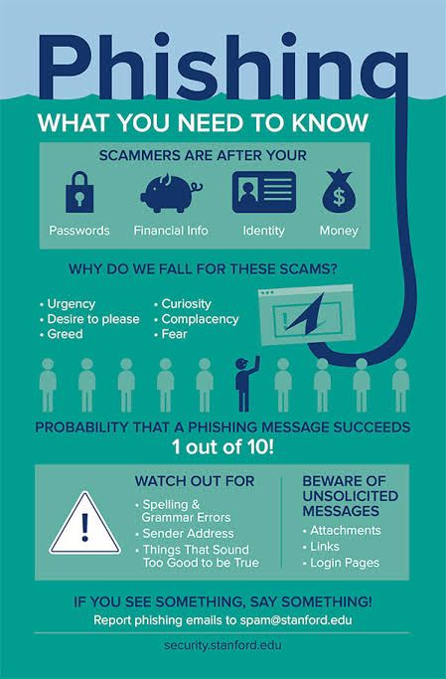
Infographic:
Signs of a Phishing Email
Suspicious Sender Address: Slight variations in legitimate email addresses.
Generic Greetings: Lack of personalization (e.g., "Dear Customer").
Grammar Mistakes: Poor spelling and grammar.
Unusual Requests: Asking for sensitive information or urgent actions.

Slide 5
Objective:
Develop a comprehensive hybrid framework using machine learning to detect and mitigate phishing email attacks.

Slide 6
Problem Statement:
High false positive rates in current phishing detection systems.
Difficulty in adapting to evolving phishing tactics.
Limitations of existing models that use either feature-based or behavior-based approaches.
Need for an integrated ML approach.

Slide 7
Literature Survey:
S.NO | Title (Name of the journal, author and publication details) | Methodology (Provide a Summary of key studies and their findings) | Identification of gaps and limitations. (Identify the limitations of the Research Paper)
1. | L. S. S. A, Y. S. V and N. Jayapandian, "Machine Learning Based Spam E-Mail Detection Using Logistic Regression Algorithm, (ICTBIG), Indore, India, 2023, pp. 1-6. | using Logistic Regression, considering data quality, feature relevance, and model adaptability. | Sensitivity to Spam Patterns Potential for False Negatives Data Imbalance Feature Extraction
2. | U. Divakarla and K. Chandrasekaran, "Predicting Phishing Emails and Websites to Fight Cybersecurity Threats Using Machine Learning Algorithms, (SMART GENCON), Bangalore, India, 2023, pp. 1-10. | Extreme Gradient Boosting (XGBoost) and Random Forest. | Dependence on Labeled Data Generalization Issues Computational Costs Overfitting Risks
3. | R. S. Al- Yozbaky and M. Alanezi, "A Review of Different Content-Based Phishing Email Detection Methods ,(IEC), Erbil, Iraq, 2023, pp. 20-25. | Supervised Learning Techniques:Hybrid Feature SelectionDeep Learning TechniquesUnsupervised | Dependence on Supervised Nature of Phishing AttacksNeed for Integration of Multiple Approaches

Slide 8
4. | S. Priya, D. Gutema and S. Singh, "A Comprehensive Survey of Recent Phishing Attacks Detection Techniques," (ICITIIT), Kottayam, India, 2024, pp. 1-6. | Machine Learning Techniques Blacklist Techniques Whitelist Techniques Fuzzv | Evolving Nature of Phishing Attacks Challenges with Public Datasets Complexity of Heuristic
5. | R. Rajoju, V. Sathvika, G. N. S. Smaran, C. Tejashwini and G. A. Reddy, "Text Phishing Detection System using Random Forest Algorithm," ,(ICAAIC), Salem, India, 2024, pp. 1332-1339 | Random forest Bag of Words Custom Feature Extraction Text Preprocessing | Dataset Size and Diversity Feature Engineering Constraints Algorithmic Bias
6. | A. I. Champa, M. F. Rabbi and M. F. Zibran, "Curated Datasets and Feature Analysis for Phishing Email Detection with Machine Learning," (ICMI), Mt Pleasant, MI, USA, 2024, pp. 1-7. | Dataset Curation Data Processing Feature Feature EngineeringMachine Learning Algorithms | Linguistic Constraints Feature Considerations Dataset Imbalance

Slide 9
7. | N. Jain, P. Jaiswal, S. Sharma, K. Sharma and V. Sharma, "A Machine Learning based Approach to Detect Phishing Attack," (ICAC3N), Greater Noida, India, 2023, pp. 305-309 | Decision Trees, Random Forest Support Vector Machines (SVM) Scikit-learn tool | Need for Large and Diverse Datasets Adversarial Attacks Feature Engineering Challenges Overfitting Risks
8. | A. I. Champa, F. Rabbi and M. F. Zibran, "Why Phishing Emails Escape Detection: A Closer Look at the Failure Points," (ISDFS), San Antonio, TX, USA, 2024, pp. 1-6 | Data Curation Quantitative Analysis Qualitative Analysis | Focus on Traditional ML Algorithms Imbalanced Datasets Limited Analysis of Failure Points
9. | Gunjan and R. Prasad, "Phishing Email Detection Using Machine Learning: A Critical Review," (IC2PCT), Greater Noida, India, 2024, pp. 1176-1180. | Support Vector Machine (SVM) Naive Bayes (NB) Logistic Regression (LR) Artificial Neural Networks (ANN) Random Forest (RF) | Limited Feature Utilization Inadequate Exploration of Attack Types Dependence on Manual Feature Engineering Accuracy of NLP Tools GPU Memory Limitations

Slide 10
10. | L. Pullagura, D. M. Rao, N. V. Kumari, R. K. Lanke, S. K. Gowda Katta and R. Chiwariro, "A Study of Suspicious E-Mail Detection Techniques," (IDCIoT), Bengaluru, India, 2024, pp. 1120-1126 | Naive Bayes Algorithm N-Gram Approach K-Nearest Neighbor (KNN) Random Weight Network (RWN) | Dependence on Training Data Adaptability Issues Heuristic Algorithm Limitations
11. | N. Jindal, D. Rastogi, K. Joshi and D. Gupta, "Identification of Phishing Attacks using Machine Learning," (ICIIP), Solan, India, 2023, pp. 941-946. | Logistic RegressionGradient BoostingExtreme Gradient BoostingMultilayer PerceptronNaive Bayes Each classifier Principal Components Analysis | Dataset Limitations Feature Selection Constraints Model Complexity Dynamic Nature of Phishing Attacks
12. | A. Chien and P. Khethavath, "Email Feature Classification and Analysis of Phishing Email Detection Using Machine Learning Techniques," (CSDE), Nadi, Fiji, 2023, pp. 1-8 | Naive Bayes, Support Vector Machine, Random Forest, and Adaboost classifier Feed Forward Neural Networks (FFNN) BERT (Bidirectional Encoder Representations | Insufficient Real Email Datasets Credibility of Features Performance Variability Limited Feature Set Algorithm Limitations

Slide 11
13. | T. Matsuda, T. Fujimaki and M. Sonoda, "Spam Email Clustering by Ordered Pair of Modality: 2023 15th International Congress on Advanced Applied Informatics Winter (IIAI-AAI-Winter)," (IIAI-AAI-Winter), Bali, Indonesia, 2023, pp. 290-295. | XGBoost Algorithm UMAP (Uniform Manifold Approximation and Projection) | Limited Data for Verification Challenges in Classification Accuracy Ineffectiveness of Traditional Features Temporal Limitations
14. | T. Ige, C. Kiekintveld and A. Piplai, "An Investigation into the Performances of the State-of-the-art Machine Learning Approaches for Various Cyber-attack Detection: A Survey," (eIT), Eau Claire, WI, USA, 2024, pp. 135-144 | Categorization of Algorithms Performance Analysis | Insufficient Research on Specific Attacks Limitations in SQL Injection Detection Performance Variability Lack of Studies on Compromised Databases
15, | K. S. Priya, J. Bala Chandrika and M. P. Lakshmi, "Machine Learning-Based Phishing Website Detection A Comprehensive Approach for Cyber security," (ICRTCST), Jamshedpur, India, 2024, pp. 344-349. | Random Forest algorithmLogistic Regression TF-IDF algorithm | Dependence on Dataset Quality Feature Selection Challenge Traditional Techniques Insufficiency

Slide 12
Existing Systems:
SpamAssassin: Combines rule-based and statistical methods; limited phishing detection.
PhishTank: Community-driven database of phishing sites; lacks real-time detection.
Google Safe Browsing: ML-based identification of phishing sites; focuses on web threats.
Microsoft Defender: ML and heuristic-based anti-phishing protection; faces challenges with false positives and evolving threats.

Slide 13
Novel Idea:
Hybrid ML model combining supervised learning (e.g., decision trees, SVM) or unsupervised learning (e.g., clustering, anomaly detection).
Improved detection of both known and novel phishing threats.

Slide 14
Research Gap:
Existing systems often use singular approaches (feature-based or behavior-based).
Limited research on effective hybrid ML models for phishing detection.
Challenges in adaptability and processing of current systems.

Slide 15
MITIGATION STRATEGY FOR PROPOSED MODEL
The aim of this mitigation strategy is to identify and extract unique "signatures" from phishing emails that can help in recognizing and blocking similar phishing attempts in the future.

Slide 16
a novel phishing signature extraction and mitigation strategy has been developed.
After identifying phishing emails, the system extracts key terms and patterns indicative of phishing behavior using the TF-IDF method. These "phishing signatures" are saved in a CSV file and used to filter incoming emails based on their similarity to known phishing patterns.
This strategy is lightweight, data-driven, and adaptive, making it easy to implement without additional hardware requirements. By continually updating the phishing signature database, this method provides a dynamic and evolving defense against phishing attacks.

Slide 17
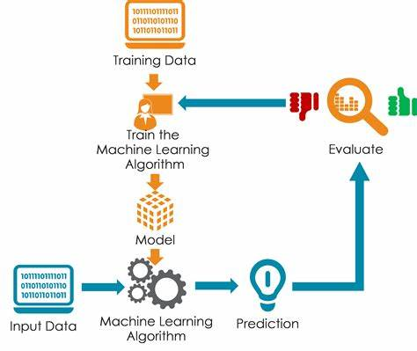
Architecture diagram for proposed model:

Slide 18
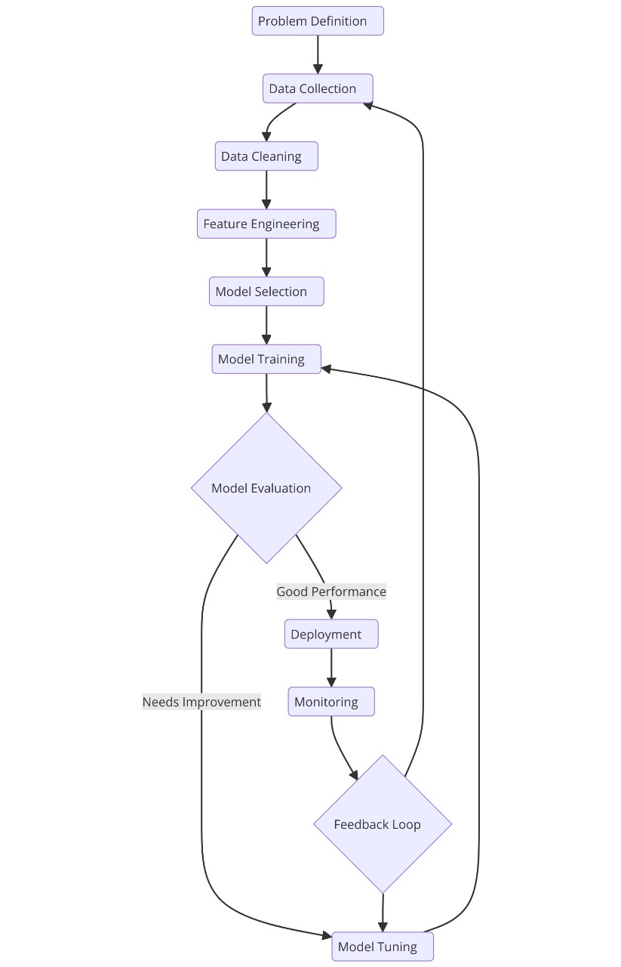
Flow Chart for proposed machine learning model:

Slide 19
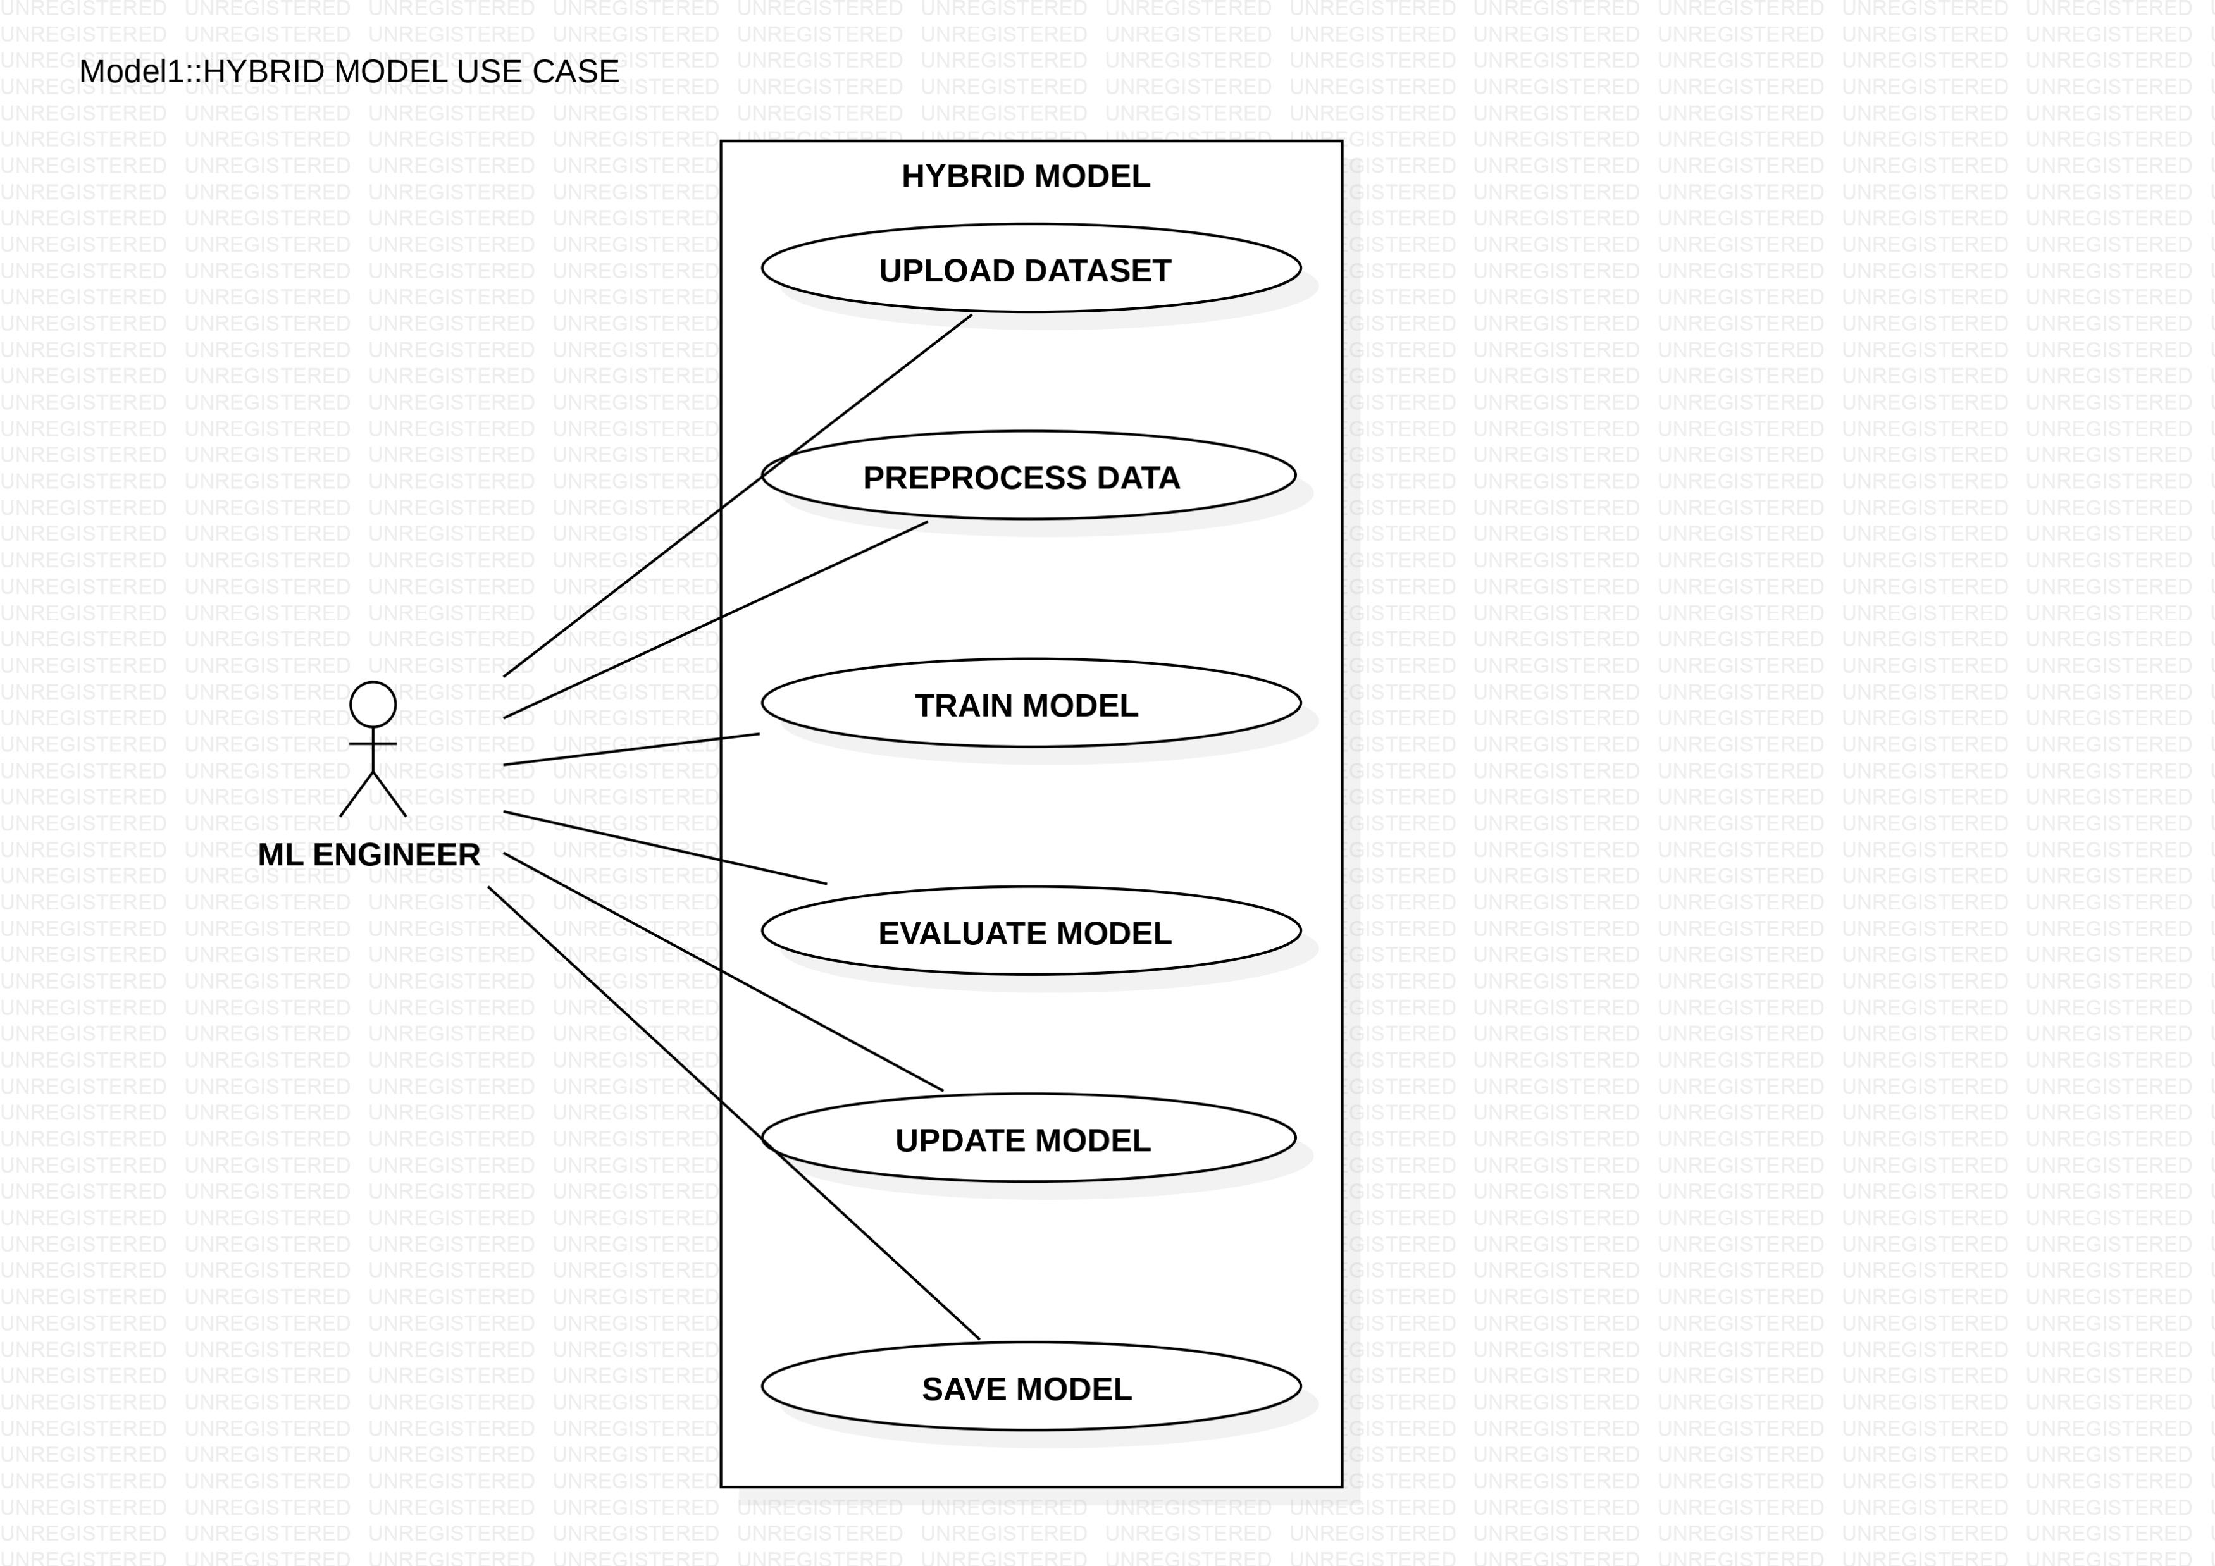
USE CASE DIAGRAM FOR PROPOSED MODEL

Slide 20
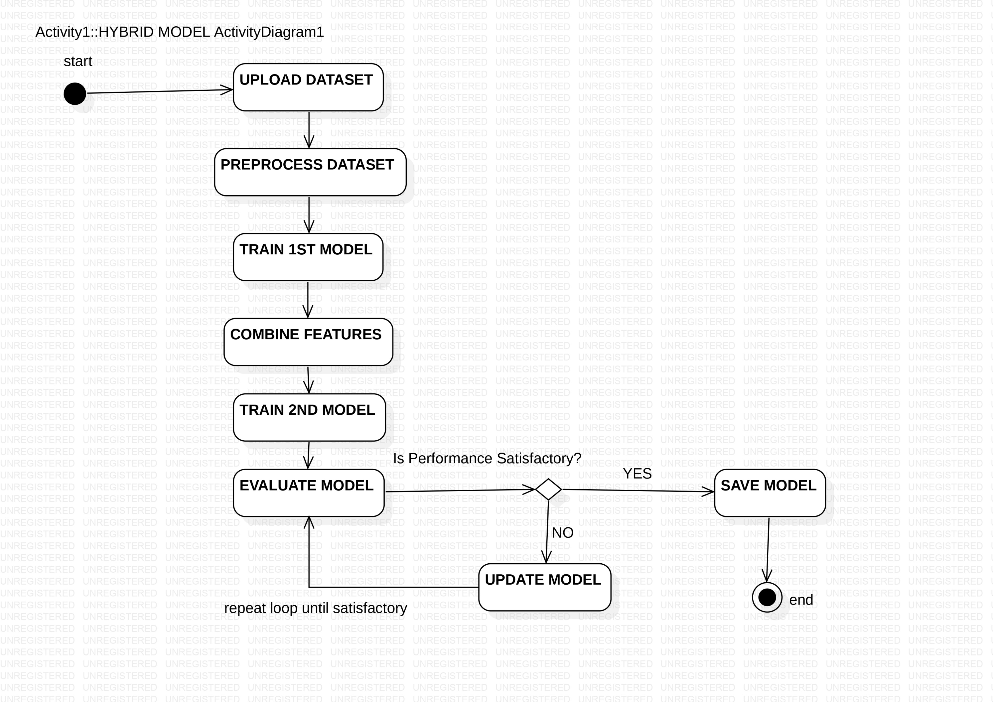
ACTIVITY DIAGRAM FOR PROPOSED MODEL

Slide 21
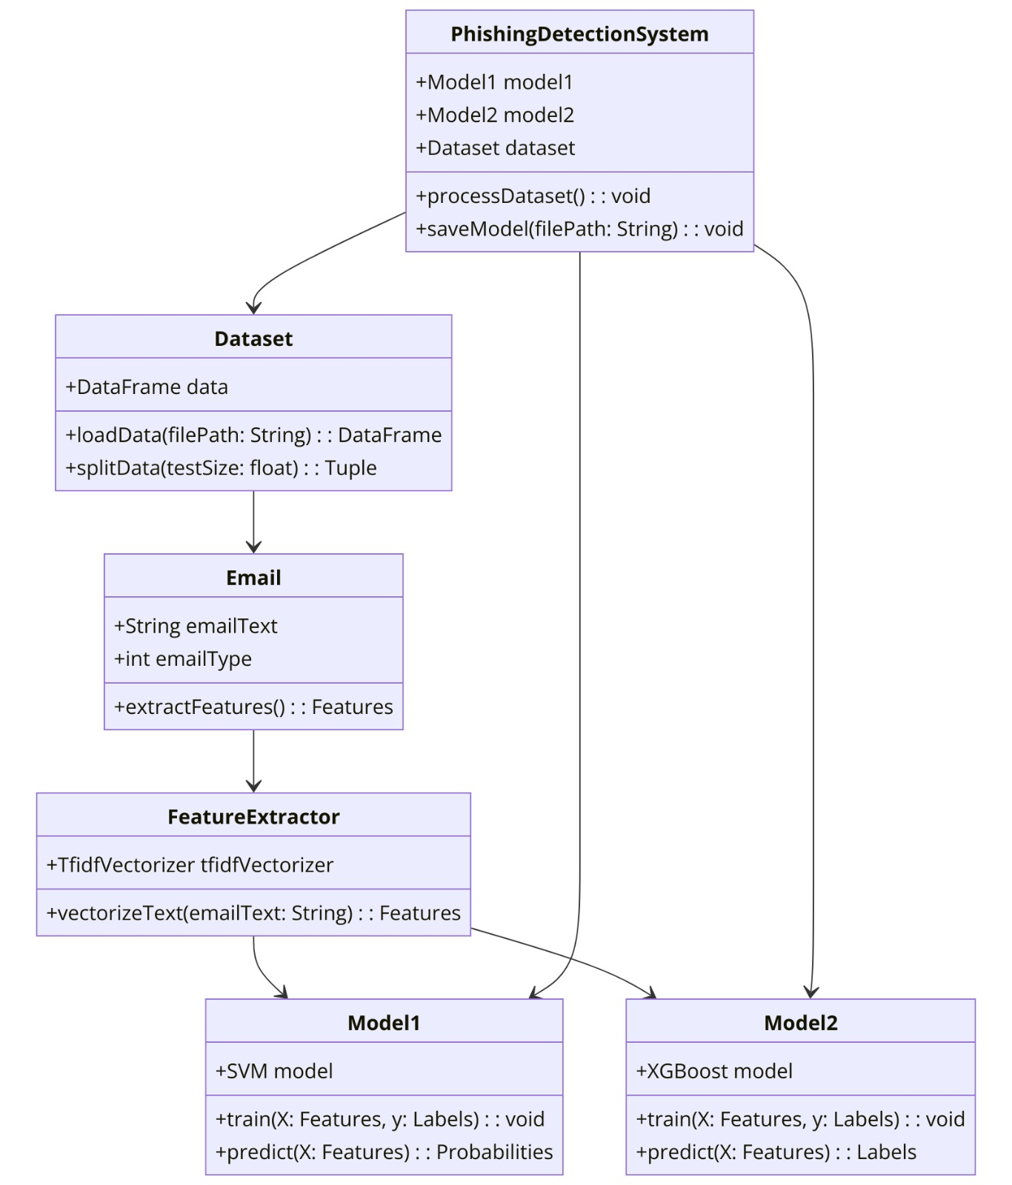
CLASS DIAGRAM FOR PROPOSED MODEL

Slide 22
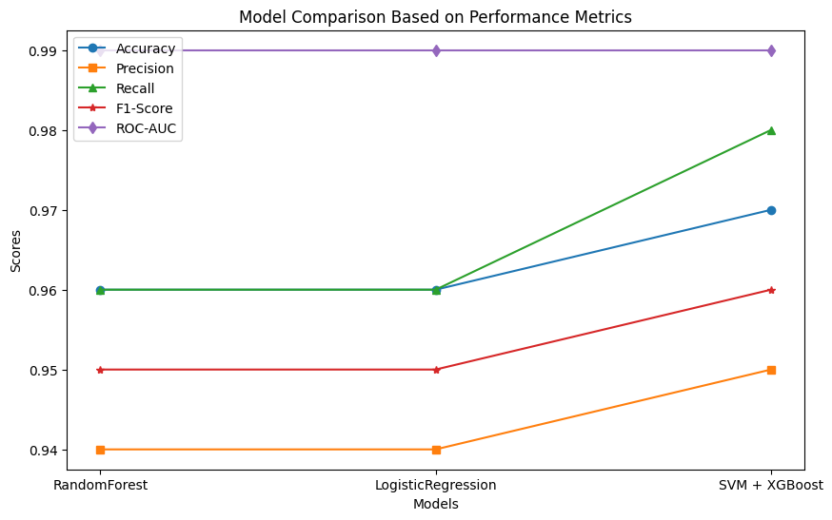
COMPARISION OF OUR MODEL

Slide 23
References:
Champa, A. I., Rabbi, M. F., & Zibran, M. F. (2024). Curated Datasets and Feature Analysis for Phishing Email Detection with Machine Learning. https://doi.org/10.1109/icmi60790.2024.10585821
Priya, S., Gutema, D., & Singh, S. (2024). A Comprehensive Survey of Recent Phishing Attacks Detection Techniques. https://doi.org/10.1109/icitiit61487.2024.10580446
Rajoju, R., Sathvika, V., Smaran, G. N. S., Tejashwini, C., & Reddy, G. A. (2024). Text Phishing Detection System using Random Forest Algorithm. https://doi.org/10.1109/icaaic60222.2024.10575110
Champa, A. I., Rabbi, F., & Zibran, M. F. (2024a). Why Phishing Emails Escape Detection: A Closer Look at the Failure Points. https://doi.org/10.1109/isdfs60797.2024.10527344
Gunjan, N., & Prasad, R. (2024). Phishing Email Detection Using Machine Learning: A Critical Review. https://doi.org/10.1109/ic2pct60090.2024.10486341
Pullagura, L., Rao, D. M., Kumari, N. V., Lanke, R. K., Katta, S. K. G., & Chiwariro, R. (2024). A Study of Suspicious E-Mail Detection Techniques. https://doi.org/10.1109/idciot59759.2024.10467633
Jain, N., Jaiswal, P., Sharma, S., Sharma, K., & Sharma, V. (2023). A Machine Learning based Approach to Detect Phishing Attack. https://doi.org/10.1109/icac3n60023.2023.10541835
Jindal, N., Rastogi, D., Joshi, K., & Gupta, D. (2023). Identification of Phishing Attacks using Machine Learning. https://doi.org/10.1109/iciip61524.2023.10537706
A, L. S. S., S, Y., & Jayapandian, N. (2023). Machine Learning Based Spam E-Mail Detection Using Logistic Regression Algorithm. https://doi.org/10.1109/ictbig59752.2023.10455970
Divakarla, U., & Chandrasekaran, K. (2023). Predicting Phishing Emails and Websites to Fight Cybersecurity Threats Using Machine Learning Algorithms. https://doi.org/10.1109/smartgencon60755.2023.10442775
Al-Yozbaky, R. S., & Alanezi, M. (2023). A Review of Different Content-Based Phishing Email Detection Methods. https://doi.org/10.1109/iec57380.2023.10438812
An Investigation into the Performances of the State-of-the-art Machine Learning Approaches for Various Cyber-attack Detection: A Survey. (2024, May 30). IEEE Conference Publication | IEEE Xplore. https://ieeexplore.ieee.org/document/10609847
Priya, K. S., Chandrika, J. B., & Lakshmi, M. P. (2024). Machine Learning-Based Phishing Website Detection A Comprehensive Approach for Cyber security. https://doi.org/10.1109/icrtcst61793.2024.10578472
Pullagura, L., Rao, D. M., Kumari, N. V., Lanke, R. K., Katta, S. K. G., & Chiwariro, R. (2024b). A Study of Suspicious E-Mail Detection Techniques. https://doi.org/10.1109/idciot59759.2024.10467633
Matsuda, T., Fujimaki, T., & Sonoda, M. (2023). Spam Email Clustering by Ordered Pair of Modality: 2023 15th International Congress on Advanced Applied Informatics Winter (IIAI-AAI-Winter). https://doi.org/10.1109/iiai-aai-winter61682.2023.00060
Rajoju, R., Sathvika, V., Smaran, G. N. S., Tejashwini, C., & Reddy, G. A. (2024b). Text Phishing Detection System using Random Forest Algorithm. https://doi.org/10.1109/icaaic60222.2024.10575110

Slide 24
thankyou

